Slide 1

Organizational Behavior
(MGT-502)
Lecture-35

Slide 2
Summary of
Lecture-34

Slide 3

Job Analysis Outcomes
  Job description
  Job specification
  Job evaluation

Slide 4

Selection
Will I get a job?

Slide 5
Common Interviewing Mistakes

Slide 6
Socialization

Slide 7

Training

Slide 8
Today’s Topics

Slide 9
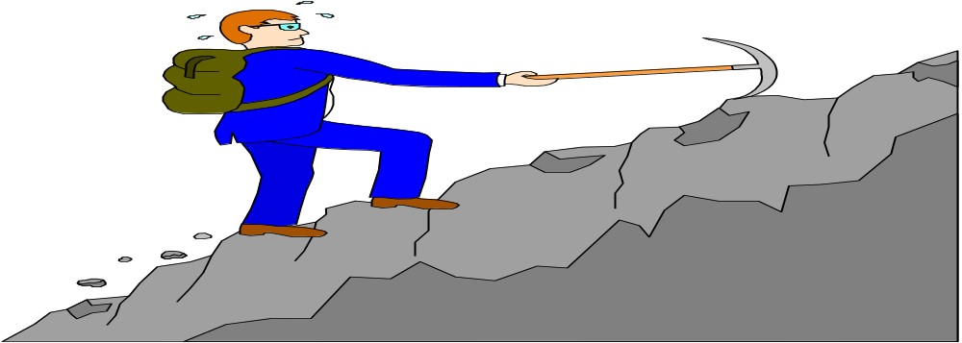
Career

Slide 10
HR’s Role in Career Development

Slide 11
The goal: match individual and organization needs
Identify career opportunities and requirements
2
1
Institute career development initiatives
Gauge
employee
potential
4
3

Slide 12
The Organization’s Responsibilities
Clearly communicating the organization’s goals and future strategies.
Creating growth opportunities.
Offering financial assistance.
Providing the time for employee to learn.

Slide 13
The Employee’s Responsibilities
Know yourself
Manage your reputation
Build and maintain network
Keep current
Balance your specialist and generalist competencies.
Document your achievements
Keep your options open

Slide 14
Performance

Slide 15
Why Do We Care?
Ability
PERFORMANCE
Opportunity
Motivation
Performance =
f (Ability, Motivation, Opportunity)

Slide 16

Performance Appraisal

Slide 17

Objectives of Performance Appraisal
Evaluation
Developmental

Slide 18
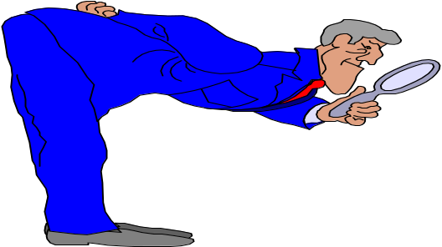



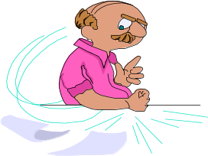
SUPERIOR
CUSTOMERS
SELF
PEERS
TEAM
SUBORDINATES

Slide 19
What Do We Evaluate?
Individual Task
Outcomes
Behaviors
Performance Evaluation
Traits

Slide 20
Common Rater Errors in PA’s

Slide 21
Supervisory Bias
Halo Effect
Central Tendency
Leniency

Slide 22
Strictness
Recency
Overall Rating

Slide 23
Manager lacks information
Lack of appraisal skills
Insufficient reward for performance
Manager not taking appraisal seriously
Performance appraisals fail because…
Unclear language
Manager not prepared
Ineffective discussion of employee development
Employee not receiving ongoing feedback
Manager not being honest or sincere

Slide 24
Suggestions for improving PA
Emphasize on behavior rather than traits
Documents performance behavior in a diary
Use multiple evaluators
Train evaluators
Train employees
Provide employees with due process
Provide performance feedback.

Slide 25


Employee Compensation

Slide 26
HR Management Strategy Model
Attract
Select
HR Strategy
Desired Results
Rewards
Retain
Engage
Develop

Slide 27
Total Compensation
Direct
Indirect
Time Not Worked
Vacations
Breaks
Holidays
Wages / Salaries
Commissions
Insurance Plans
Medical
Dental
Life
Bonuses
Gainsharing
Security Plans
Pensions
Employee Services
Educational assistance
Recreational programs
Notes:
6

Slide 28
Pay-for-Performance

Slide 29
Six Criteria of Value of Performance

Slide 30
Quality
Quantity
Timeliness
Cost-effectiveness
Need for supervision
Interpersonal impact

Slide 31
Turnover
Absenteeism
Rewards
Attendance

Slide 32
Positive consequence
(reinforced by reward)
Repeated
Behavior
Not repeated
Negative consequence
(no reward)

Slide 33

Unions

Slide 34
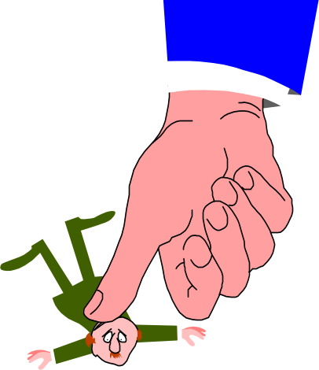
Union Benefits
Higher wages and benefits
Influence work rules
Greater job security
Dealing with management

Slide 35
Managing Diversity in Organizations
Work -Life Conflicts
Work
Personal
Life

Slide 36
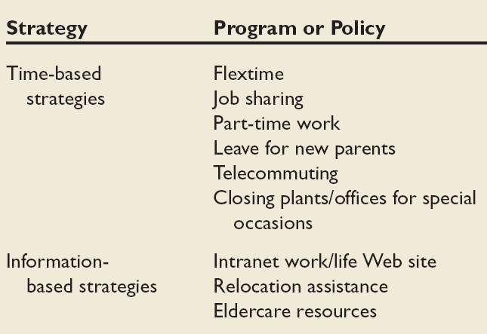
Work/Life Initiatives

Slide 37
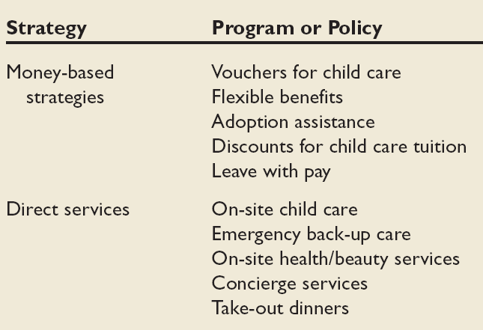
Work/Life Initiatives (cont’d)

Slide 38
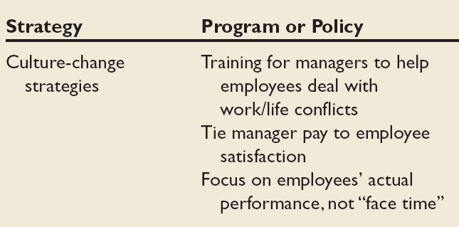
Work/Life Initiatives (cont’d)

Slide 39

Managing Diversity in Organizations (cont’)
Diversity Training
  Participants learn to value individual differences, increase cross-cultural understanding, and confront stereotypes.
  A typical diversity training program:
    Lasts for half a day to three days.
    Includes role-playing exercises, lectures, discussions, and sharing experiences.

Slide 40
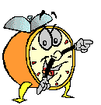
Let’s stop it here

Slide 41
Summary

Slide 42
Career

Slide 43
Performance

Slide 44
Performance Appraisal

Slide 45
Common Rater Errors in PA’s

Slide 46
Employee Compensation

Slide 47
Pay-for-Performance

Slide 48
Managing Diversity in Organizations
Work -Life Conflicts
Work
Personal
Life

Slide 49
Next….

Slide 50
Organizational Behavior
(MGT-502)
Lecture-35

